Slide 1

ENHANCING FRAUD DETECTION BY FEATURE SELECTION USING FLOOD METAHEURISTIC ALGORITHM
PRESENTED BY-
ARYAK SRIVASTAVA 22052445
BHUMI JAISWAL 22052454
ISHANI SENGUPTA 22052460
RICHA KUMARI 22052492
UNDER THE SUPERVISION OF-
Dr. Partha Pratim Sarangi
[1]

Slide 2
INTRODUCTION
Overview of Fraud Detection
Definition: Identification of fraudulent activities in sectors like banking, insurance, and e-commerce.
Importance: Protects financial assets and maintains organizational reputation.
Challenges Faced
Increasing fraudulent activities leading to significant financial losses.
Traditional methods struggle with high-dimensional data and class imbalance, resulting in reduced accuracy and increased false positives.
[2]

Slide 3
Problem Statement
Key Challenges in Fraud Detection
High-Dimensional Feature Spaces: Difficulty in identifying relevant features.
Noisy Data: Impacts model performance and accuracy.
Class Imbalance: Leads to biased predictions and increased false positives.
Proposed Solution
Implementation of the Flood Algorithm (FLA) for effective feature selection to enhance model performance.
[3]

Slide 4
METHODOLOGY
Project Execution Steps:-
Data Collection: Utilized benchmark fraud datasets (e.g., credit card transactions).
Data Preprocessing: Included cleaning, standardization, and handling missing values.
Feature Selection: Employed FLA and Sphere Function for optimizing feature sets.
Model Training: Trained classifiers including KNN, SVM, and RF on optimized features.
Evaluation: Analyzed performance using metrics like accuracy, precision, recall, and F1-score.
[4]

Slide 5
Data Collection
Datasets Used
Description of benchmark datasets (e.g., credit card transactions, insurance claims) that are widely recognized in the research community.
Size and characteristics of datasets (e.g., number of features, instances, and class distribution).
Data Sources
Publicly available datasets from reputable sources (e.g., Kaggle, UCI Machine Learning Repository) that provide a diverse range of fraud scenarios for analysis.
[8]

Slide 6
Data Preprocessing
Steps Involved
Data Cleaning: Handling missing values, duplicates, and outliers to ensure data integrity.
Normalization: Scaling features to a uniform range (e.g., Min-Max scaling) to improve model convergence.
Encoding Categorical Variables: Converting categorical data into numerical format using techniques like one-hot encoding or label encoding.
Importance of Preprocessing
Ensures data quality, reduces noise, and improves model performance by providing a clean and structured dataset for training.
[9]

Slide 7
Flood Algorithm (FLA)
Overview of FLA
Inspired by the natural flow of water, mimicking erosion and sediment transport.
Balances exploration of new solutions and exploitation of promising ones.
Key Properties
Self-Adaptive Exploration: Dynamically adjusts search processes for improved convergence.
High Efficiency in Feature Selection: Eliminates redundant features, enhancing accuracy.
Robustness Against Noisy Data: Improves model stability and reduces overfitting.
[5]

Slide 8
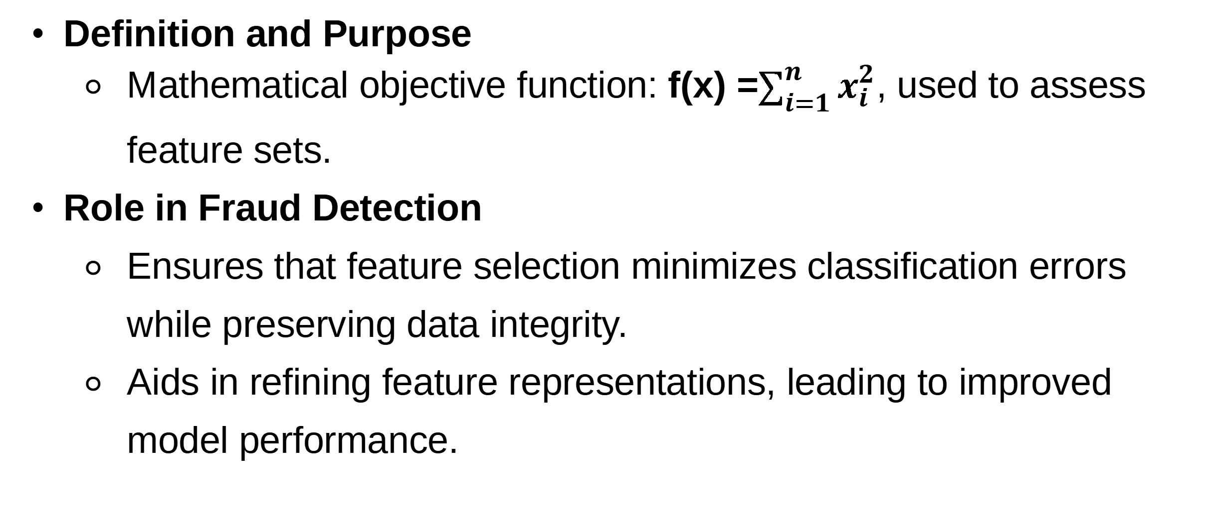
Sphere Function in Feature Transformation
Definition and Purpose
Mathematical objective function: f(x) =$\sum_{i=1}^{n}{x_{i}^{2}}$, used to assess feature sets.
Role in Fraud Detection
Ensures that feature selection minimizes classification errors while preserving data integrity.
Aids in refining feature representations, leading to improved model performance.
[6]

Slide 9
Binary Particle Swarm Optimization (PSO) in Fraud Detection
A variant of Particle Swarm Optimization designed for binary optimization problems.
Utilizes binary representation (0s and 1s) to indicate feature selection.
Benefits in Fraud Detection:
Efficient Feature Selection: Identifies relevant features, enhancing model performance.
Reduced Computational Cost: Minimizes features for faster training and evaluation.
Improved Accuracy: Focuses on informative features, increasing detection accuracy.
[8]

Slide 10
Classification Models
Classification Models
Models Utilized in the Study
K-Nearest Neighbors (KNN): A simple, instance-based learning algorithm that classifies based on the majority class of nearest data points. With BPSO accuracy is 95%.
Support Vector Machine (SVM): A powerful classifier that finds the optimal decision boundary to separate classes in high-dimensional space. With BPSO accuracy is 93%.
Random Forest (RF): An ensemble method that combines multiple decision trees to enhance prediction accuracy and reduce overfitting. With BPSO accuracy is 96%.
[7]

Slide 11
RESULTS AND ANALYSIS
Results and Analysis
Performance Metrics Overview
Evaluated models based on accuracy, precision, recall, F1-score, and false positive rate.
Results Comparison
Accuracy improvements with FLA:
KNN: Increased from 95% to 97.78%
SVM: Increased from 93% to 98%
RF: Increased from 96% to 97.59%
→ Best Accuracy with SVM using Flood Algorithm.
[10]

Slide 12
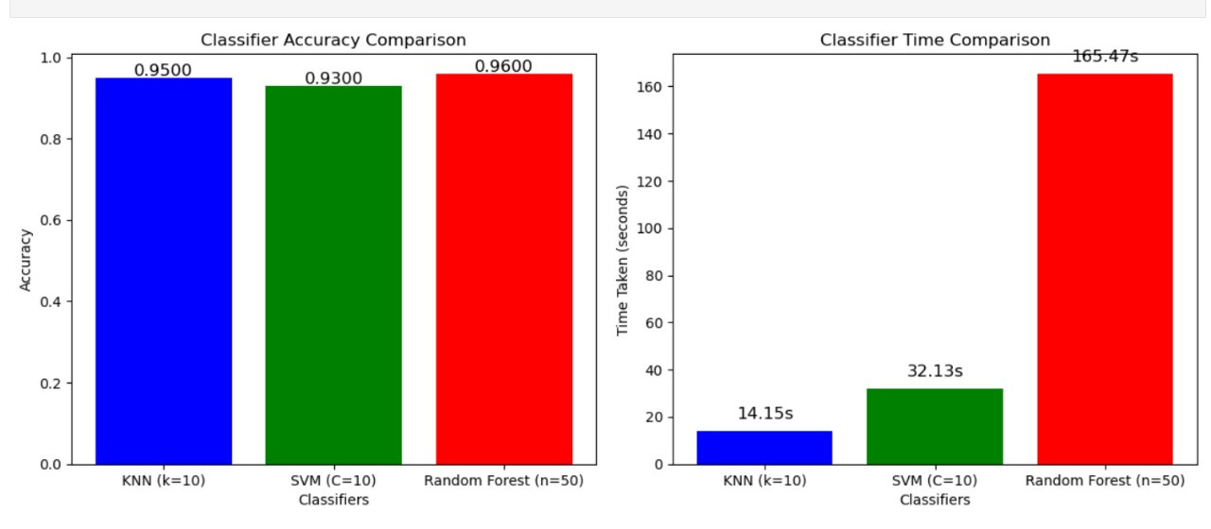
RESULTS AND ANALYSIS :-
Comparison of Classifier Performance (Accuracy vs. Time) Using Binary PSO-Based Feature Selection
[11]

Slide 13
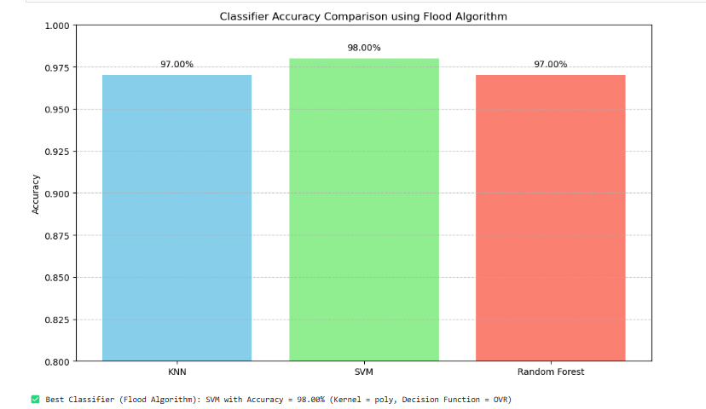
VISUAL REPRESENTATION
[12]

Slide 14
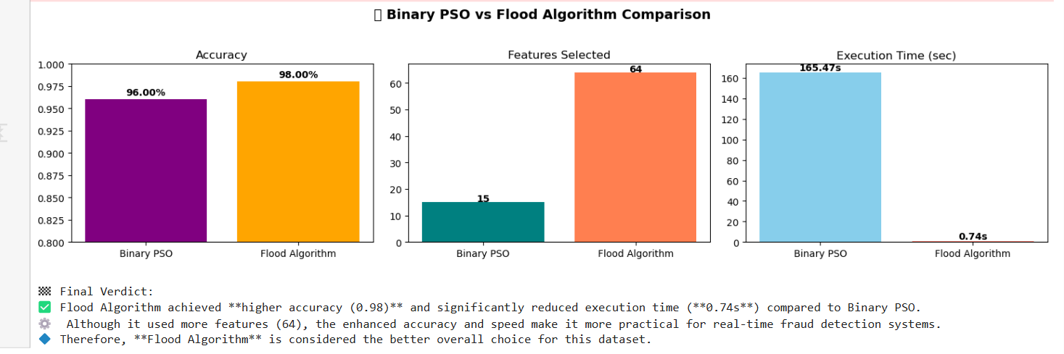
VISUAL REPRESENTATION
[12]

Slide 15
Quality Assurance
Testing and Validation Procedures
Data Validation: Ensured clean datasets by checking for missing values and duplicates.
Cross-Validation: Applied 5-fold cross-validation to mitigate overfitting.
Performance Metrics Evaluation: Monitored accuracy, precision, recall, F1-score, and false positive rates.
Reproducibility Measures
Fixed random seeds and documented all parameters to ensure consistent results.
[13]

Slide 16
Conclusion
Key Findings and Contributions
The FLA significantly enhances fraud detection accuracy and reduces computational costs.
Demonstrated effectiveness in minimizing false positives, making it suitable for real-time applications.
Implications for Industry
The proposed model can be integrated into existing fraud detection systems to improve their efficiency and reliability.
[14]

Slide 17
Future Scope
Potential Areas for Development
Real-Time Implementation: Adapt the model for dynamic management of streaming transaction data.
Hybrid Optimization Techniques: Combine FLA with other metaheuristic algorithms (e.g., Genetic Algorithm, Particle Swarm Optimization) for improved feature selection.
Deep Learning Integration: Explore the use of deep learning models (e.g., CNNs, LSTMs, Transformers) for more precise fraud pattern recognition.
[15]

Slide 18
Thank you
[16]

